Slide 1
rajeshwari vedachalam govt arts college chengalpattu pg department of computer science
Guide : Dr. T. Vani
Team Members
Subash.G
Lokesh.S
Joshwa.D
Parthiban.L

Slide 2
Telecom Customer Retention Using Machine Learning

Slide 3
Introduction
Intelligent customer retention is a technique that uses machine learnin algorithms to analyze customer data and predict which customers are likely to churn.
This technique can help telecom companies to take proactive measures to prevent customer churn, such as offering incentives, improving service quality, or offerin new services that meet the needs of the customer.

Slide 4
Define Problem / Problem Understanding
Specify the bussiness problem.
Intelligent customer retention using machine learning is an effective way to predict and prevent customer churn in the telecom industry.
According to literature survery , In recent years ML as a powerful tool for predicting and enhancing customer retention strateies.
Social or Business Impact.

Slide 5
Data Collection & Preparation
Collect the relevant data source
for telecom customer churn.
Importing the necessary libraries.
Read the Dataset.
Data Preparation : Handling the
missing values, Categorical Values, Imbalance Data.

Slide 6
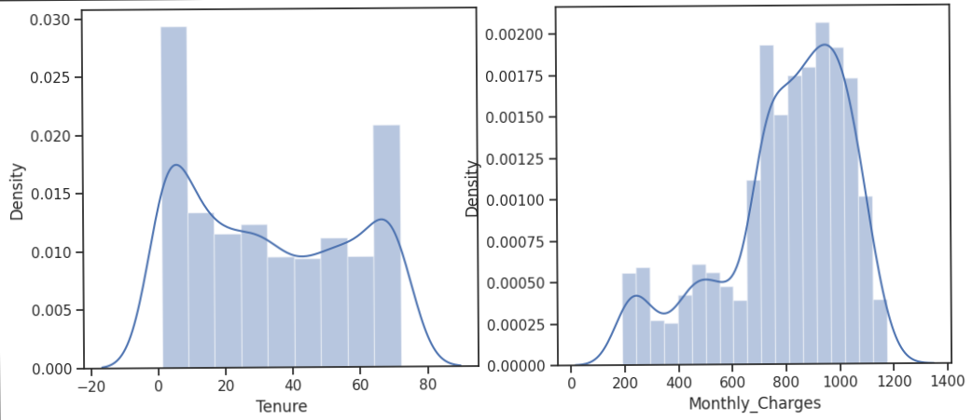
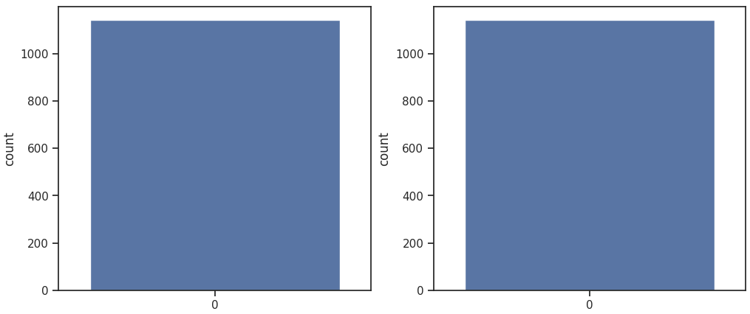
Exploratory Data Analysis
Descriptive analysis is to study the basic
features of data with the statistical process.
Visual analysis is the process of using visual
representations, such as charts, plots, and graphs,
to explore and understand data.
Univariate analysis, Bivariate analysis,
Multivariate analysis to represent in graph.
Scaling the data and Splitting data into train and test.

Slide 7
Model Building
Training the model in multiple algorithms to build the model.
Decision tree, Random forest, KNN, Xgboost models are created and train and test data are passed as the parameters.
Building and training an Artificial Neural Network(ANN) using the keras library .
Testing th mode.

Slide 8
Performance Testing & Hyperparameter Tuning
Testing model with multiple evaluation metrics.
Compare the model.
Comparing model accuracy before & after applyinghyperparameter tuning.

Slide 9
Model Deployment
Saving the best model after comparing its performance.
Integrate with Web Framework : Building a web application that is integrated to the model.
Building HTML pages and Python codes and import libraries then finally run the web application into our system.

Slide 10
Conclusion
We have developed the machine learning project using python programming language an the reports as shown the above

Slide 11
Thank you

